Slide 1
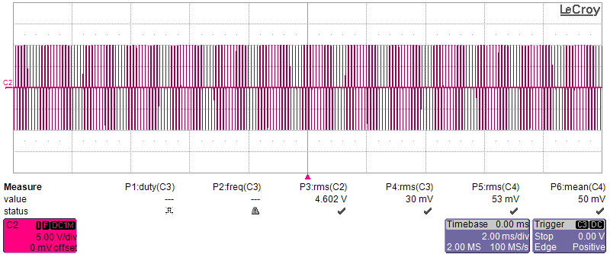
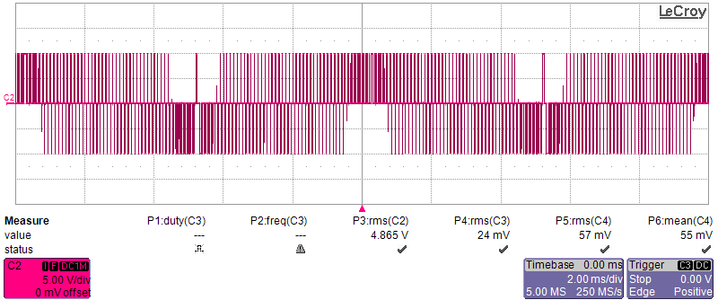
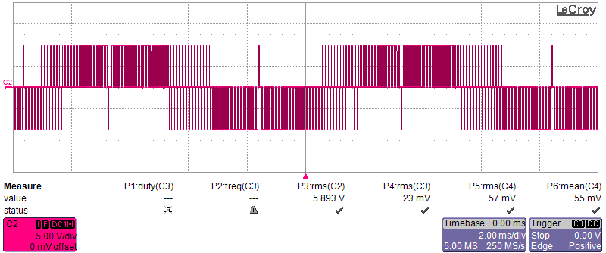
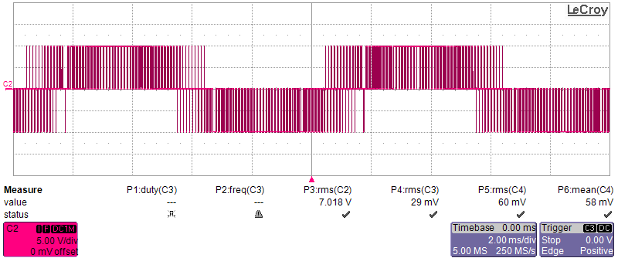




$$m_{a}=0, f_{sw}=10kHz, f_{o}=100Hz$$
$$m_{a}=0.3, f_{sw}=10kHz, f_{o}=100Hz$$
5V/div 2ms/div
5V/div 2ms/div
(a)
(b)
$$m_{a}=0.6, f_{sw}=10kHz, f_{o}=100Hz$$
$$m_{a}=0.86, f_{sw}=10kHz, f_{o}=100Hz$$
5V/div 2ms/div
5V/div 2ms/div
(c)
(d)

Slide 2
5V/div 2ms/div
5V/div 2ms/div
(a)
(b)
5V/div 2ms/div
5V/div 2ms/div
(c)
(d)

Slide 4
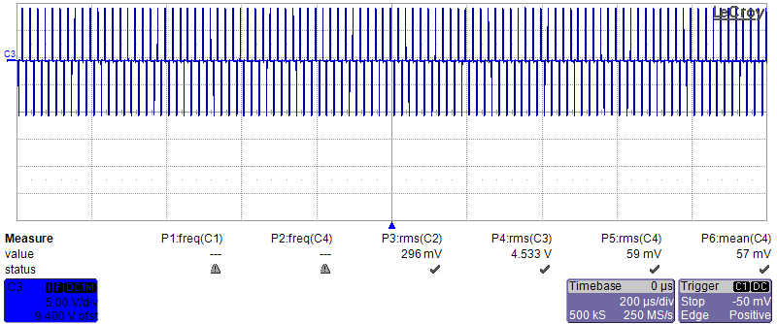
0.43

Slide 5
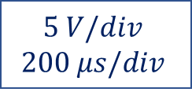
0.43
$$5 V/div$$
$$200 μs/div$$

Slide 6
0.43
$$5 V/div$$
$$200 μs/div$$

Slide 7
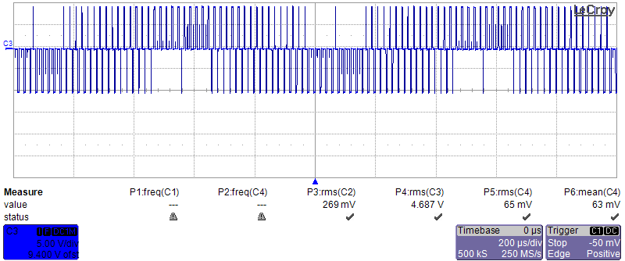
0.42
0.23
0.02
0.02

Slide 8
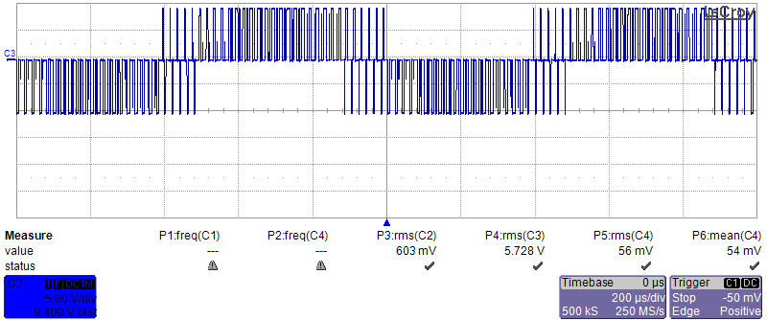
0.48
0.40
S0.10
0.10

